Slide 1


Email Management System
OTRS Service Desk

Slide 2
Overview
OTRS Help Desk
Ticket Management
Self Service
Reporting
Knowledge Management
Access Management
A comprehensive support and service desk software solution that enables agents to answer a high volume of customer requests quickly, effectively and, above all, transparently.
Featuring a logical structured approach and automation of repetitive tasks, together with maximum flexibility and customized configuration possibilities to enhance productivity of service and help desks across many verticals such as Travel, Hospitality, Tech Support, Customer Service etc.
The Eurus EMS is based on the globally renowned OTRS system with hundreds of thousands of satisfied users across the world.
Eurus Internetworks Pvt. Ltd., New Delhi

Slide 3
How it Works
Request (Ticket) Generation
Each service request is referred to as a ‘Ticket’ and automatically assigned a unique ‘Ticket Number’.
Requests (Tickets) could come in via multiple inputs: Web, e-mail, phone, or SOAP/XML
Automated customer entry via Computer Telephony Integration (CTI) support.
Request (Ticket) Classification
OTRS provides a comprehensive set of tools to view, sort, manage, respond, escalate and resolve service requests (Tickets).
As soon as a Ticket is received and logged, an auto generated response (fully configurable) is sent back to the requester with the assigned Ticket Number.
The Ticket is then placed in the appropriate queue and available for agents to work on it.
Eurus Internetworks Pvt. Ltd., New Delhi

Slide 4
Ticket Management
Basic Ticket Handling
Configurable queues and watch lists
Configurable incident classifications and prioritization
Ticket response templates for quick and efficient incident handling
Self- service customer front-end
SLA and queue based escalation
Event-driven notifications of ticket status changes
Intelligent Automation
Auto-response templates for recurring requests
Automated and manual incident routing
Automatic follow-up to existing tickets
Automated execution of pre-defined actions using criterion-based filters
Eurus Internetworks Pvt. Ltd., New Delhi

Slide 5
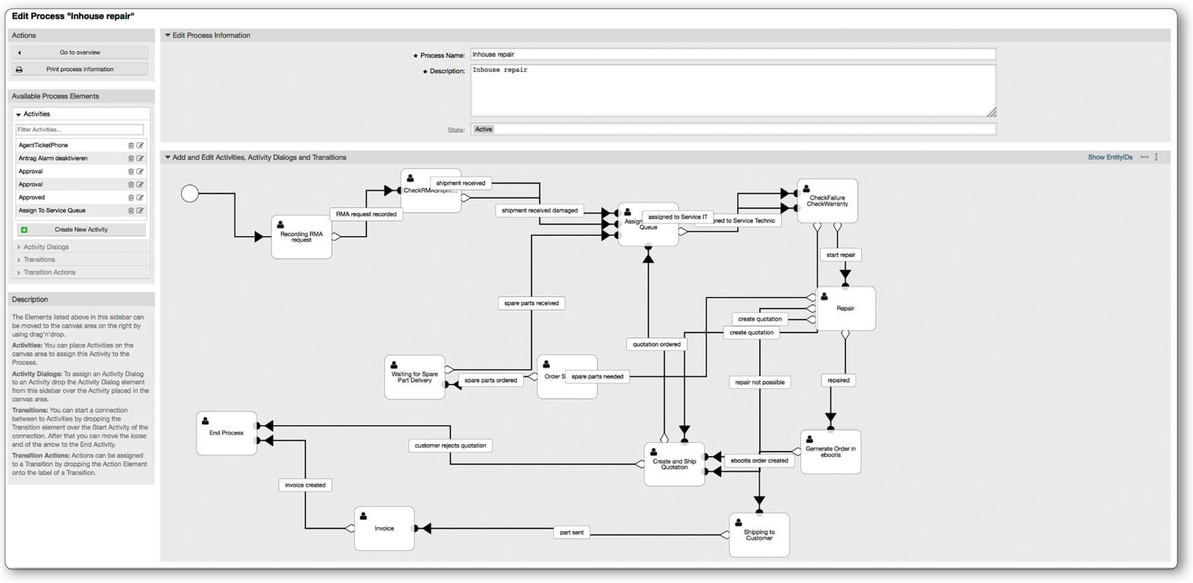
Efficient Automation of Business Processes
Create efficient and clear processes in your company and increase productivity and work quality across departments. OTRS offers you the possibility to design your own processes with a wide range of automation. Process tickets can be created with configurable forms and routed through several process steps involving different departments. This makes approval processes as well as complex ordering processes more coordinated and, therefore, faster. In addition, OTRS also offers the following automation features:
Event-based Generic Agent for moving tickets into queues, changing the status or sending automatic email notifications
Postmaster filter to move tickets into queues according to keywords in the subject
Ticket Bulk feature to process a large amount of tickets with one click
Master Slave feature to process changes in the master ticket in assigned slave tickets as well
Automatic creation and follow-up from SMS alerts

Slide 6
Viewing, Browsing, Searching
Viewing Tickets
Queue View- Your subscribed queues
Escalation View-Sorted by remaining time to escalation
Status View- sorted by current status
Expandable article trees. (‘Article’ refers to a single message in tree that may consist of several messages exchanged back and forth)
Search
Optimized full text search
Efficient ticket lookup
Linking & splitting of tickets and FAQ articles.
Eurus Internetworks Pvt. Ltd., New Delhi

Slide 7
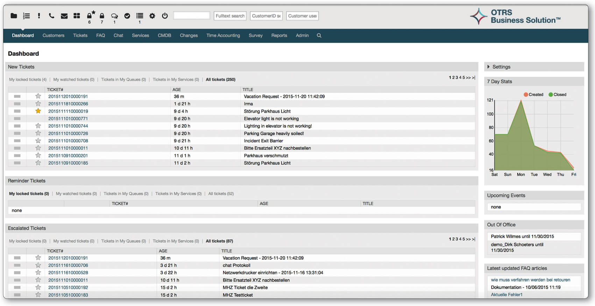
Control with Agent Dashboard
Maximum information and adaptability to your needs – That’s the essence of the agent dashboard of the service desk software OTRS. It’s composed of single widgets that can be rearranged, removed or added at any time. The top menu can also be organized via drag and drop. Above all, the OTRS agent dashboard offers the following features:
Overviews of new, open, watched, escalated or pending tickets, as well as running process tickets
Overviews that can be filtered flexibly according to priority, escalation time, SLA, service, type, etc.
Overview of and subscription to queues and services you want to get email notifications from
Email notifications about new tickets and changes, enabling work outside of the agent interface
Ticket lock and unlock feature to prevent two agents from working on a ticket at the same time
Clear and traceable assignment of owners and individuals responsible for working on tickets
Out-of-office feature and visualization of agents that are away
Powerful search feature
7-Day statistics
Further statistics on number of tickets and processing time

Slide 8
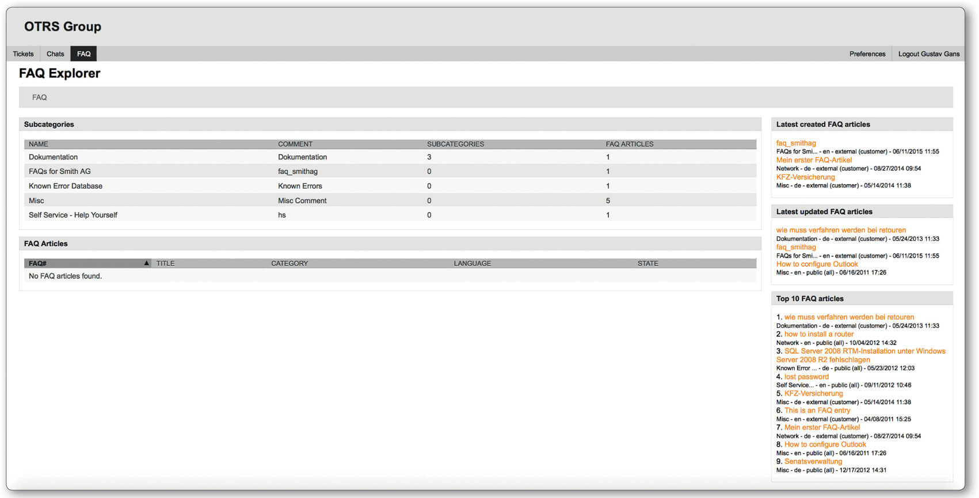
Knowledge Management and Self-Service
Knowledge documentation and customer self-service made easy – The OTRS “FAQ” feature offers the possibility of documenting incident solutions and service desk agent know-how, and of having those entries reviewed and rated by others. To offer self-service to customers, thus taking a load off your service desk, the FAQ articles can also be displayed in the OTRS Customer Portal or on any other website using the free FAQ connector. OTRS offers you the following functionalities:
FAQ articles can be created, reviewed, released and enhanced with attachments
Support for translations
Clear history of changes
Rating feature for quality assurance
Linking of FAQ articles with tickets and services to quickly send a solution
Full-text search to find FAQ articles faster
Define different categories to restrict access for certain user groups

Slide 9
Knowledge Management
The knowledge base enables faster problem resolution and allows employees quick access to information.
Eurus Internetworks Pvt. Ltd., New Delhi

Slide 10
Flexible Structure
Define categories according to your needs and for cross-departmental usage
Eurus Internetworks Pvt. Ltd., New Delhi

Slide 11
Approval Process
An integrated approval process may be enabled, to notify your knowledge base editors on new or modified articles that need their attention and approval to become available.
Eurus Internetworks Pvt. Ltd., New Delhi

Slide 12
Root Cause Analysis
It is easy as linking one or more tickets to a KB article. This relation becomes visible for every agent
Eurus Internetworks Pvt. Ltd., New Delhi

Slide 13
Self Service
Customers can register and manage their own accounts, create new tickets, review ticket history and escalate tickets for specialized processing.
Eurus Internetworks Pvt. Ltd., New Delhi

Slide 14
Anytime, Anywhere Access
Separate customer front-end, accessible via a standard Web browser
24/7/365 access
Simple and easy to use
Eurus Internetworks Pvt. Ltd., New Delhi

Slide 15
Ticket Management Tools
Customers can log, manage and track service requests over the web
Complete access to previous ticket history
Real-time information on ticket status and process
Event-driven notification
Eurus Internetworks Pvt. Ltd., New Delhi

Slide 16
Reporting
The system Includes a set of commonly used reports and allows customizable reporting to answer specific business questions.
Eurus Internetworks Pvt. Ltd., New Delhi

Slide 17
Dashboard
At-a-glance information on key statistics, allowing fast and efficient view of up-to-date performance summaries
Allows customized widgets to be plugged in to meet advanced reporting requirements
Eurus Internetworks Pvt. Ltd., New Delhi

Slide 18
Report Creation
Menu-Driven custom report creation without programming
Create reports based on the whole data stored in the OTRS database
Save frequently-used reports
Eurus Internetworks Pvt. Ltd., New Delhi

Slide 19
Data Import and Export
Export reports, graphics and analysis data to printer, PDF or CSV
Eurus Internetworks Pvt. Ltd., New Delhi

Slide 20
Access Management
Comprehensive permission management allows a granular access on a specific level according to the users individual role.
Eurus Internetworks Pvt. Ltd., New Delhi

Slide 21
Accessibility
Access to OTRS with a Web browser
Customizable agent preferences allows to define access to specific queue notification
Eurus Internetworks Pvt. Ltd., New Delhi

Slide 22
Authentication
Agent and customer user authentication against LDAP directories
Customer user authentication against a Radius Server
Eurus Internetworks Pvt. Ltd., New Delhi

Slide 23
Role Based Access
Support of user accounts, groups and roles
Customer self-registration to the self-service portal based on preset permissions.
Eurus Internetworks Pvt. Ltd., New Delhi

Slide 24
Access Control Lists
Access Control Lists(ACLs) supplement existing permissions provided by roles and groups.
Grant access to tickets, queues, function and allow specific actions based on attributes
Allow to map and manage workflows in OTRS
Eurus Internetworks Pvt. Ltd., New Delhi

Slide 25
Thank You

